Slide 1


“If you want to find the secrets of the universe, think in terms of energy, frequency and vibration.” ― Nikola Tesla-
Fleacho

Slide 2
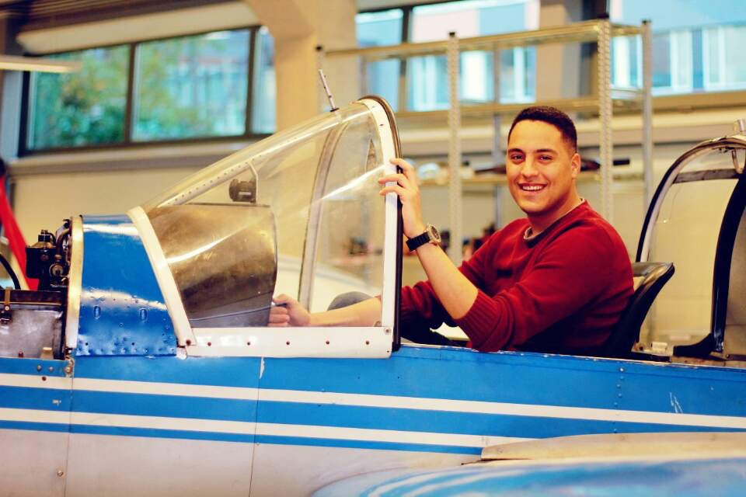



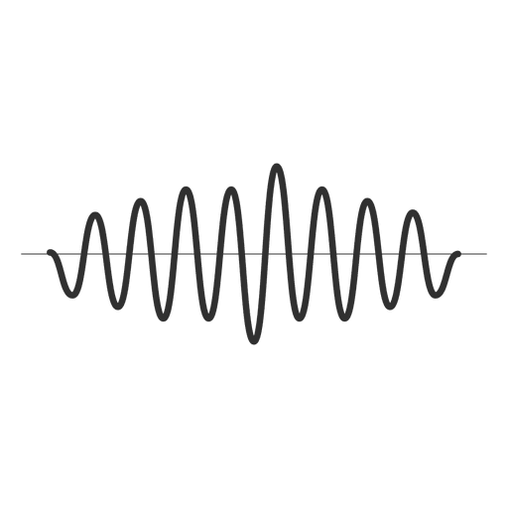
FLEACHO
Mustafa
Hustler
Ahmed
Hacker
Yasser
Designer
Jeonghwan
Visionary

Slide 3
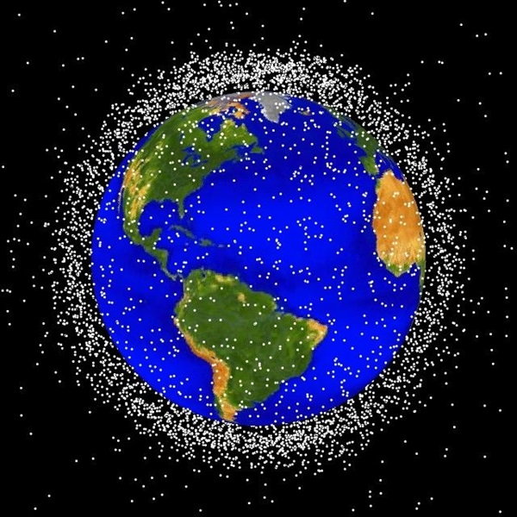
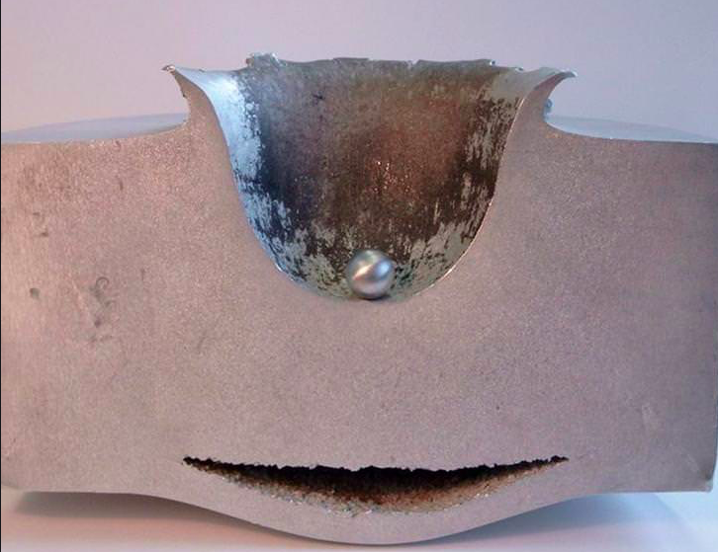
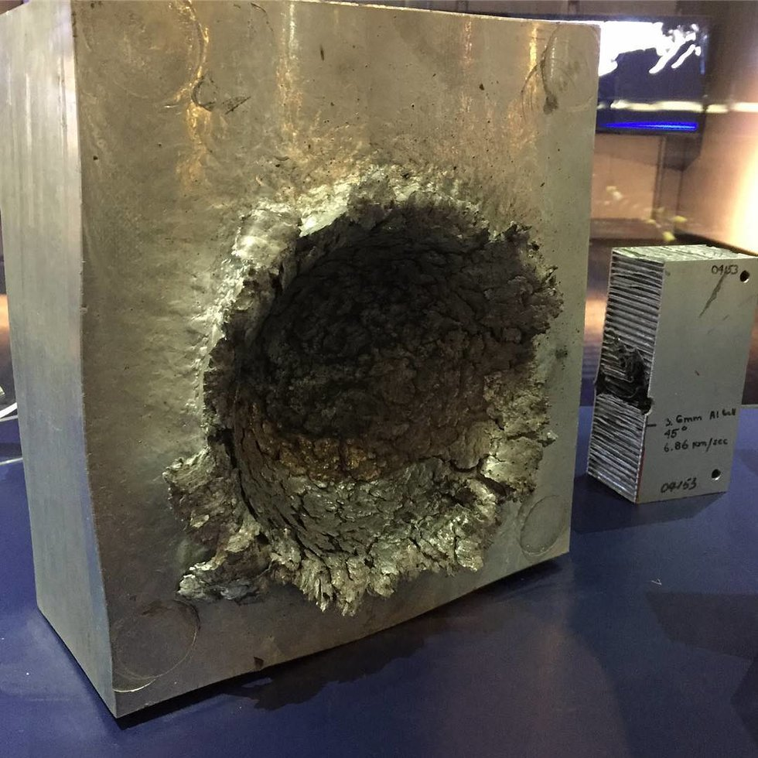
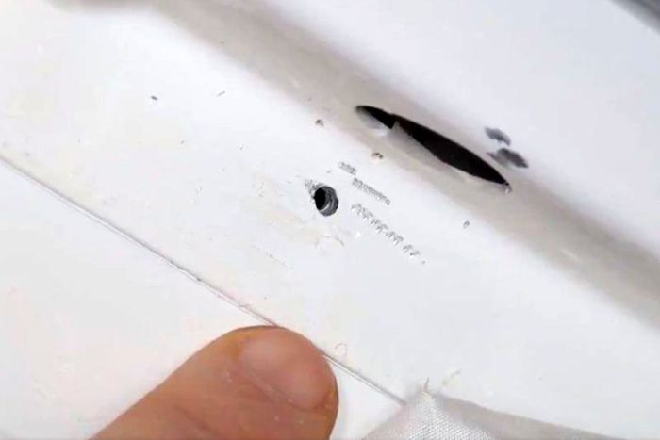
Background
Micro-Meteoroid and Orbital Debris(MMOD) have a significant threat to space exploration
Average impact speeds for orbital debris on spacecraft: 10 km/s, and 20 km/s for micrometeoroids
International Space Station
Although the ISS uses Whipple shielding to protect itself from minor debris, portions (notably its solar panels) cannot be protected easily
Figure 1. Low Earth orbit - Approximately 95 percent of the objects denoted in this graphic are debris
Figure 2. Shield – How The International Space Station protect itself from space debris
Figure 3. The effect of 14gram debris on solid aluminum
Figure 4. a tiny hole discovered in a Russian capsule docked at the International Space Station

Slide 4
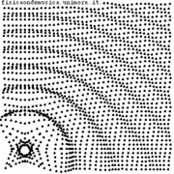
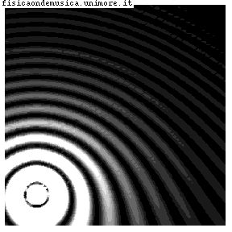
Solution
Sound waves are used to determine the damaged parts of the ISS
The monitors show the graphs that astronauts could easily check the unusual patterns
The cheapest and fastest way to detect damages in a structure from MMOD
Figure 5.
Figure 6.

Slide 5
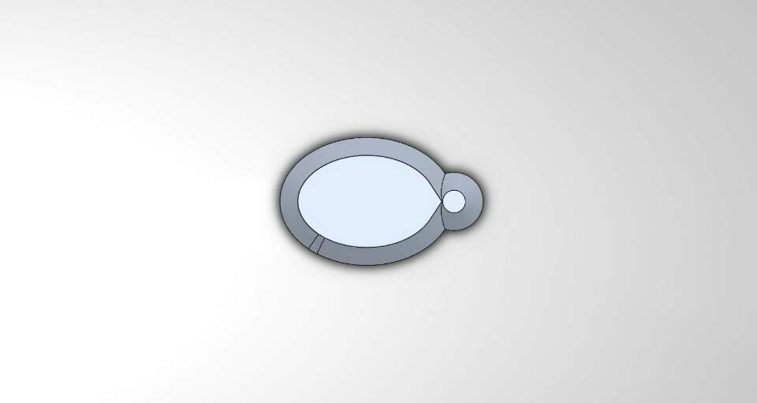
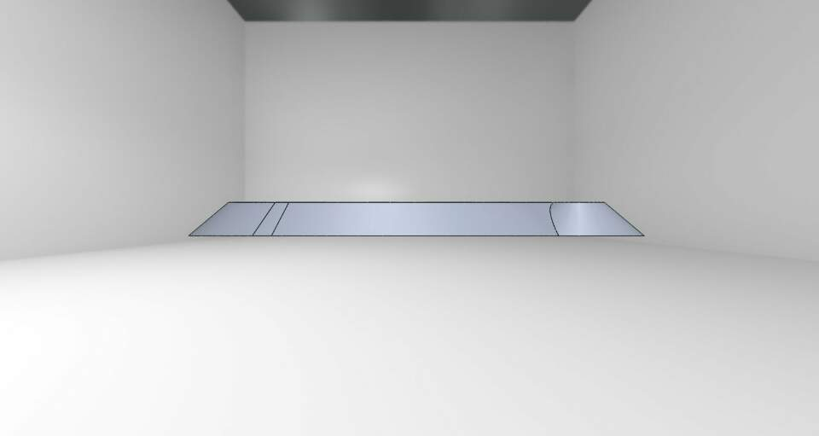
prototype
Figure 7.
Figure 8.

Slide 6
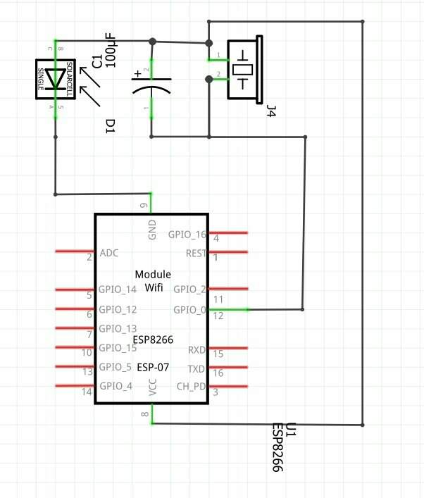
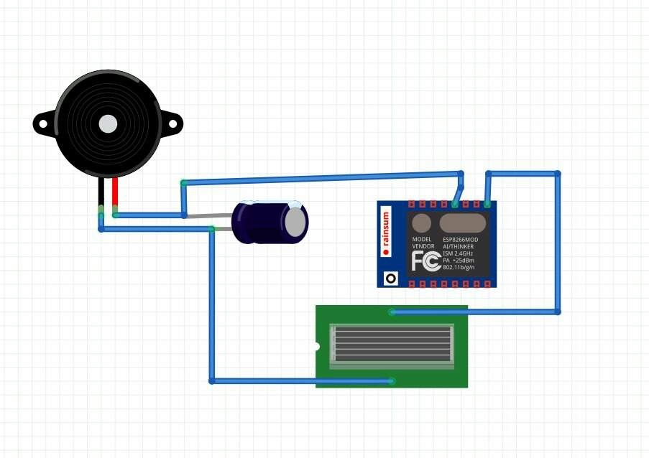
Core concept
Microphone and speaker are used to send and receive sound waves using piezoelectric
Figure 7. schematic diagram
Figure 8. schematic diagram

Slide 7
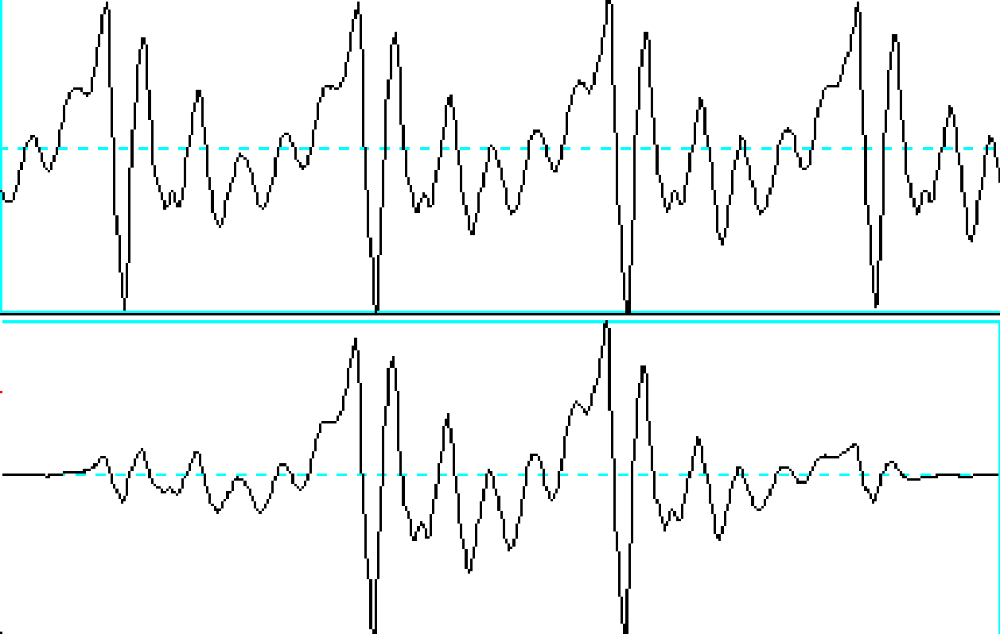
Core concept
Analyze the data collected from sound waves
Damaged parts affect the wave, length and speed of signals
The monitor in ISS inform you if there is unusual patterns
Figure 9. The above graph shows the steady movement whereas the below graph does not

Slide 8
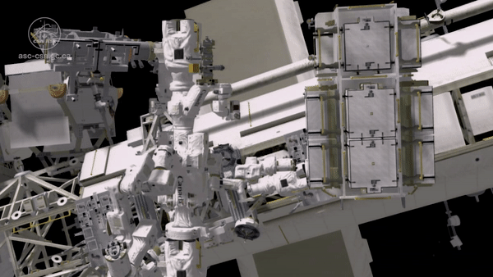
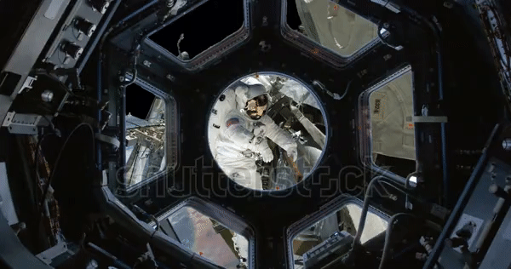
Core concept
Astronauts examine the unusual waves and fix damaged parts of ISS
Figure 10. Dextre in ISS
Figure 11.

Slide 9
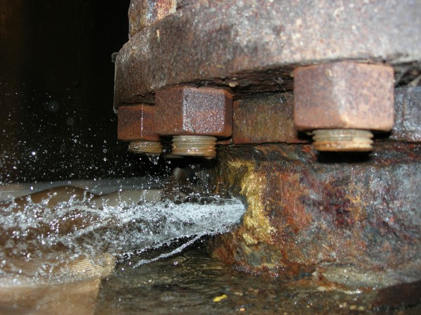
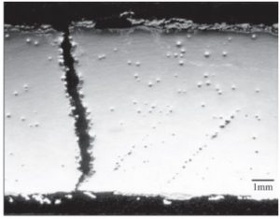
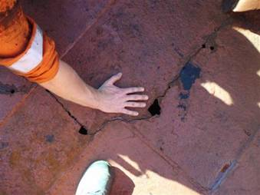
Future
Save time and life
Saving significant amount of time in inspecting ISS for damage and the lives of astronauts
Combine with machine learning and artificial intelligence(AI)
Computer analyzes data and controls Dextre to repair damaged parts without human intervention
Apply to other industries
Power plant
Maritime industry
Figure 12. Broken nuclear power plant pipe
Figure 13. Power plant boiler tube failure
Figure 14. Hairline cracks in vessel

Slide 10
Q & A

Slide 11
References
Figure 1: http://www.astronomy.com/news/2017/12/space-junk-sensor
Figure 2: https://imgur.com/gallery/BCN1A
Figure 3: https://bigthink.com/news/heres-the-damage-a-tiny-speck-of-space-debris-can-do-at-15000mph
Figure 4: https://www.abc.net.au/news/2018-09-06/russia-investigates-if-space-station-leak-sabotage/10207344
Figure 5 & 6: http://fisicaondemusica.unimore.it/Rifrazione_del_suono_en.html
Figure 10: http://www.fonetiks.info/praat/praat.htm
Figure 11: http://www.asc-csa.gc.ca/eng/iss/dextre/about.asp
Figure 12: https://www.shutterstock.com/ko/video/clip-27579400-observing-astronaut-fixing-iss-through-space-station
Figure 13: https://allthingsnuclear.org/dlochbaum/nuclear-pipe-nightmares
Figure 14: https://reneweconomy.com.au/coal-fired-power-stations-dont-work-well-old-72946/
Figure 15: http://ports.co.za/news/article_2009_10_28_4704.html
https://en.wikipedia.org/wiki/Space_debris

